Slide 1
INTRODUCTION TO COMPUTING
Course Code: CCINCOM/L
Deep Q-Learning
Elizer Ponio Jr.
Faculty Member
Department of Computer Science
College of Computing and Information Technologies (CCIT)
National University
Joseph Marvin R. Imperial
REINFORCEMENT LEARNING
NU College of Computing and Information Technologies
Course Code: CCRNFLRL

Slide 2
Large Scale Reinforcement Learning
INTRODUCTION TO COMPUTING
Course Code: CCINCOM/L
In the last unit, we learned our first reinforcement learning algorithm: Q-Learning.
We got excellent results with this simple algorithm, but these environments were relatively simple because the state space was discrete and small (8 to 16 different states for FrozenLake.
For comparison, the state space in Atari games like Space Invaders can contain 109109 to 10111011 states.
Producing and updating a Q-table can become ineffective in large state space environments.
Instead of using a Q-table, Deep Q-Learning uses a Neural Network that takes a state and approximates Q-values for each action based on that state.
Joseph Marvin R. Imperial
REINFORCEMENT LEARNING
NU College of Computing and Information Technologies
Course Code: CCRNFLRL

Slide 3
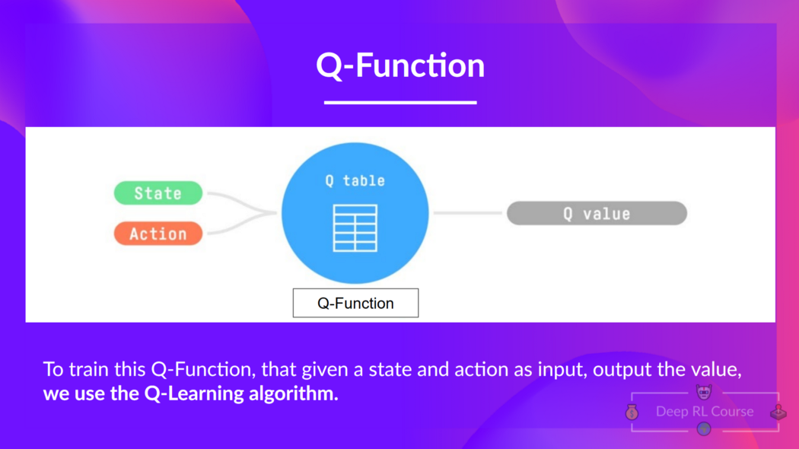
Refresher (Q-Learning)
INTRODUCTION TO COMPUTING
Course Code: CCINCOM/L
We learned that Q-Learning is an algorithm we use to train our Q-Function, an action-value function that determines the value of being at a particular state and taking a specific action at that state.
Joseph Marvin R. Imperial
REINFORCEMENT LEARNING
NU College of Computing and Information Technologies
Course Code: CCRNFLRL

Slide 4
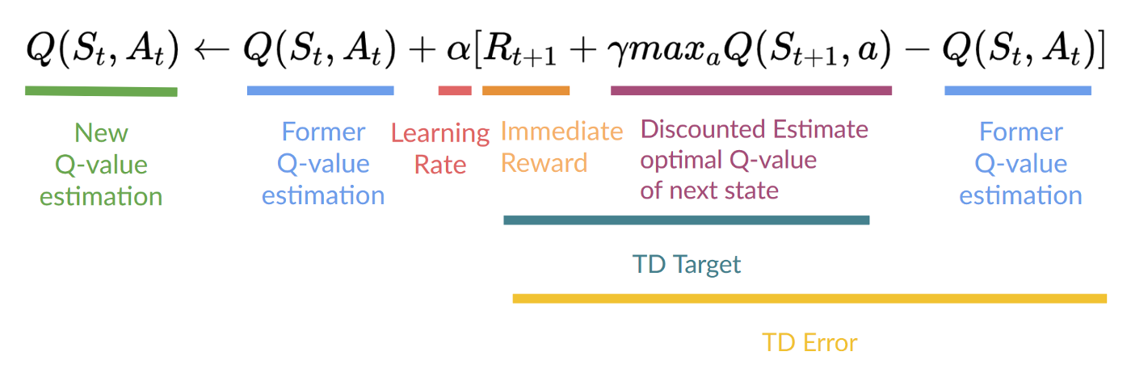
Refresher (Q-Learning)
INTRODUCTION TO COMPUTING
Course Code: CCINCOM/L
Internally, our Q-function is encoded by a Q-table, a table where each cell corresponds to a state-action pair value. Think of this Q-table as the memory or cheat sheet of our Q-function.
The Q comes from “the Quality” of that action at that state. The Q-function in each cell is calculated at each step using the update rule:
Joseph Marvin R. Imperial
REINFORCEMENT LEARNING
NU College of Computing and Information Technologies
Course Code: CCRNFLRL

Slide 5
Limitations of Q-Learning
INTRODUCTION TO COMPUTING
Course Code: CCINCOM/L
The problem is that Q-Learning is a tabular method. It is not scalable.
This becomes a problem if the states and actions spaces are not small enough to be represented efficiently by arrays and tables.
Q-Learning worked well with small state space environments like:
FrozenLake, we had 16 states.
Taxi-v3, we had 500 states.
Joseph Marvin R. Imperial
REINFORCEMENT LEARNING
NU College of Computing and Information Technologies
Course Code: CCRNFLRL

Slide 6
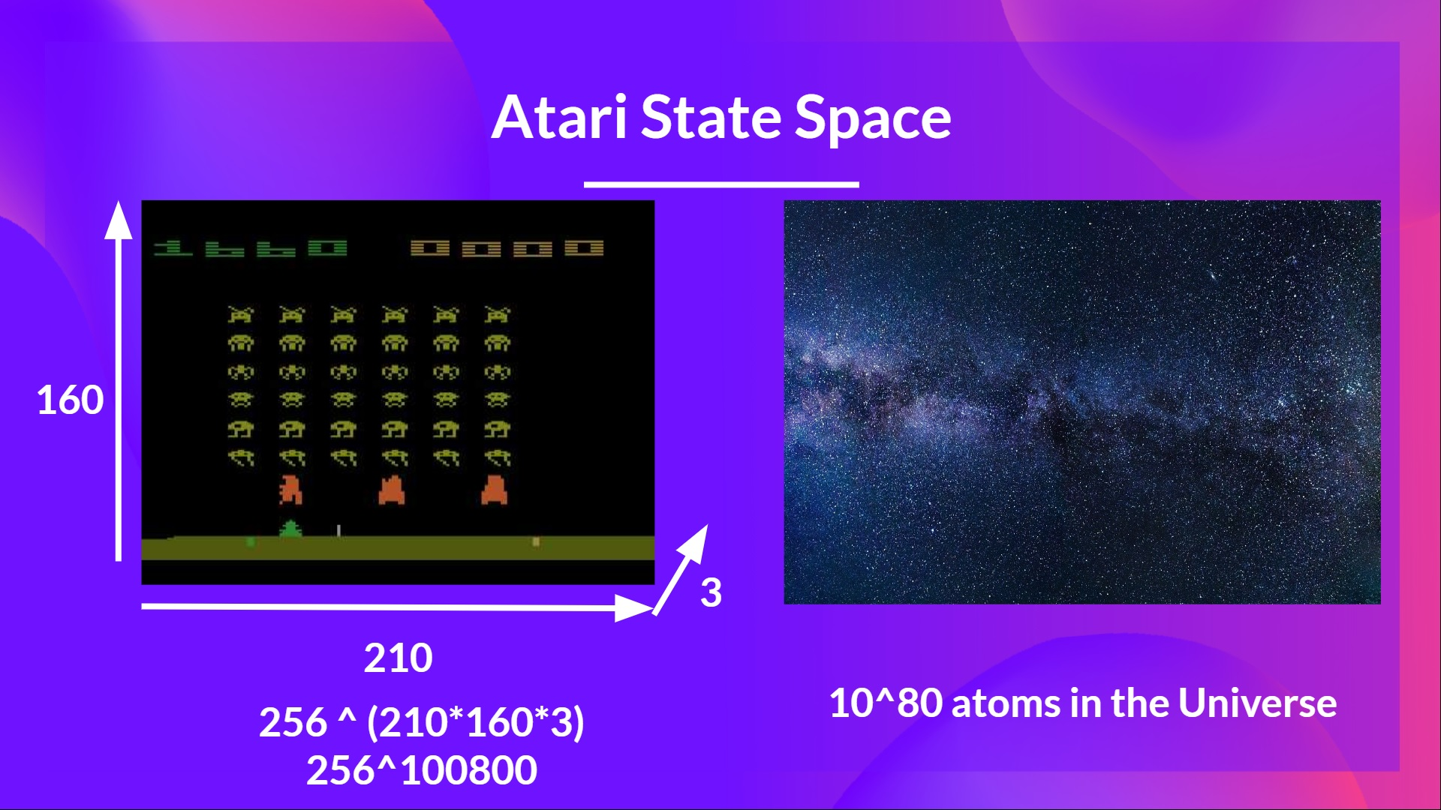
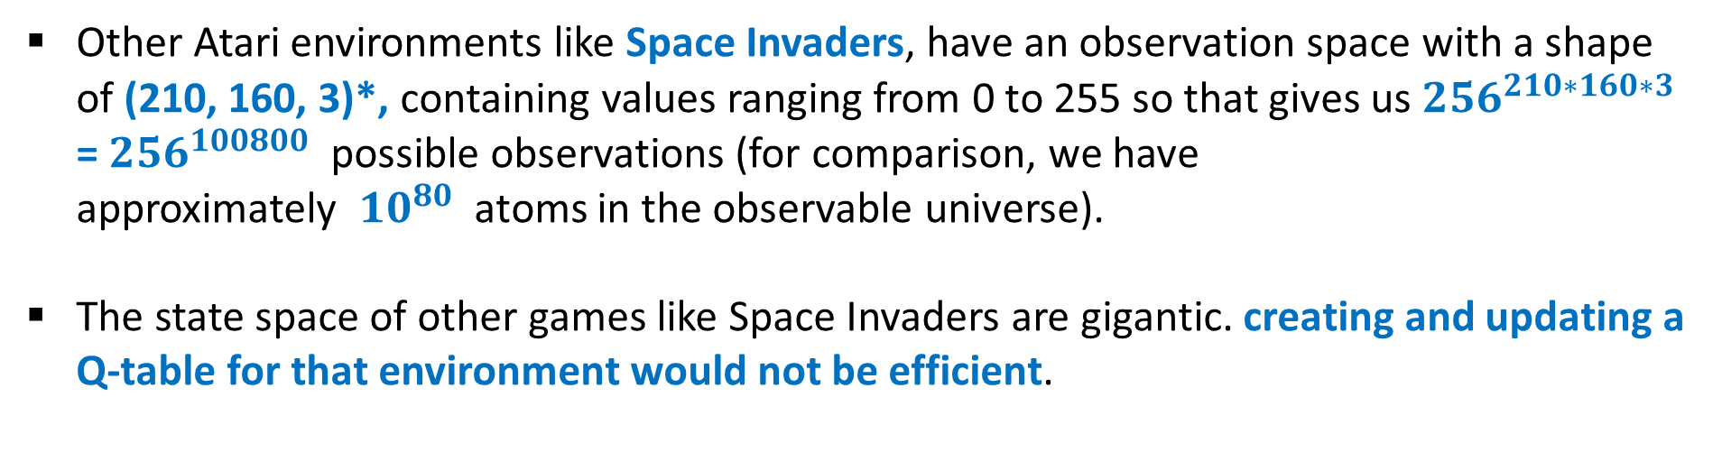
Limitations of Q-Learning
INTRODUCTION TO COMPUTING
Course Code: CCINCOM/L
Other Atari environments like Space Invaders, have an observation space with a shape of (210, 160, 3)*, containing values ranging from 0 to 255 so that gives us ${256}^{210∗160∗3}$ = ${256}^{100800}$ possible observations (for comparison, we have approximately ${10}^{80}$ atoms in the observable universe).
The state space of other games like Space Invaders are gigantic. creating and updating a Q-table for that environment would not be efficient.
Joseph Marvin R. Imperial
REINFORCEMENT LEARNING
NU College of Computing and Information Technologies
Course Code: CCRNFLRL

Slide 7
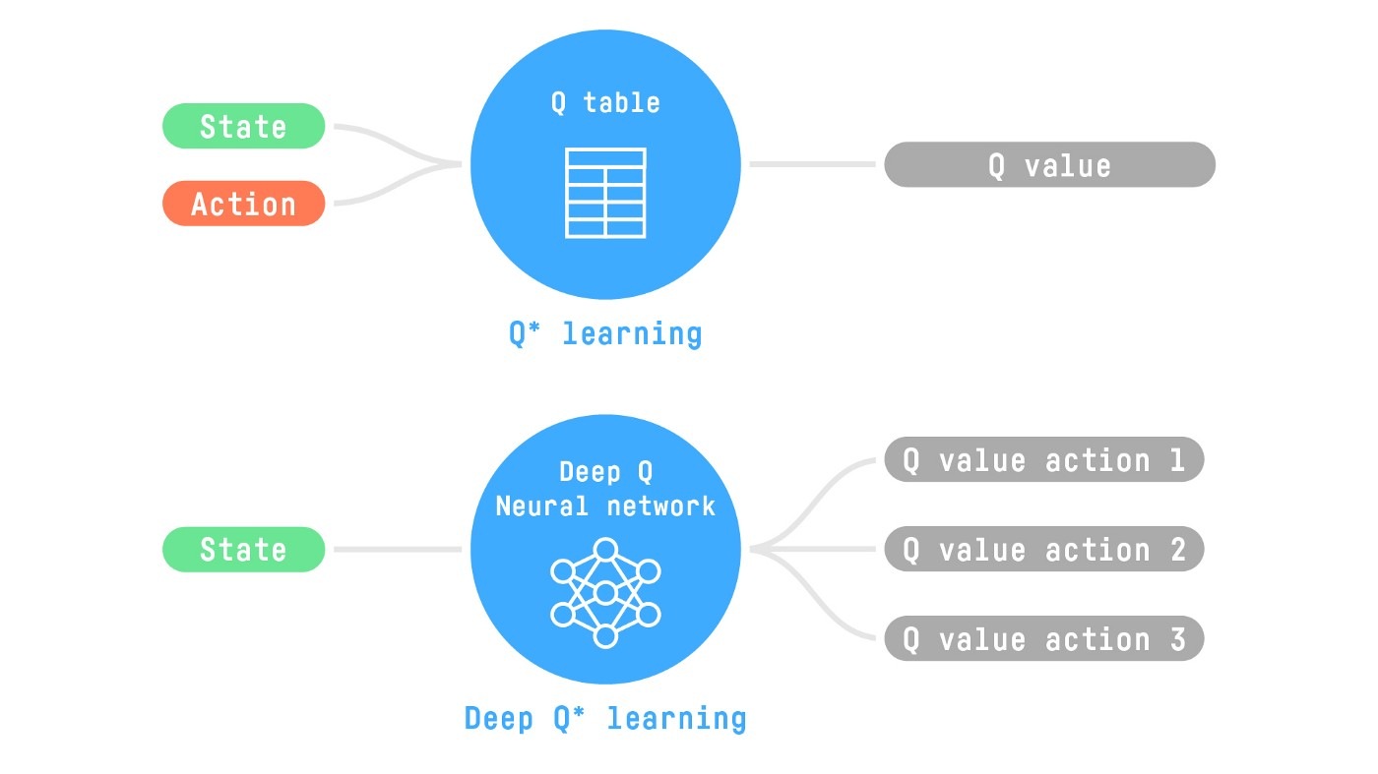
Limitations of Q-Learning
INTRODUCTION TO COMPUTING
Course Code: CCINCOM/L
In this case, the best idea is to approximate the Q-values using a parametrized Q-function.
This neural network will approximate, given a state, the different Q-values for each possible action at that state.
Joseph Marvin R. Imperial
REINFORCEMENT LEARNING
NU College of Computing and Information Technologies
Course Code: CCRNFLRL

Slide 8
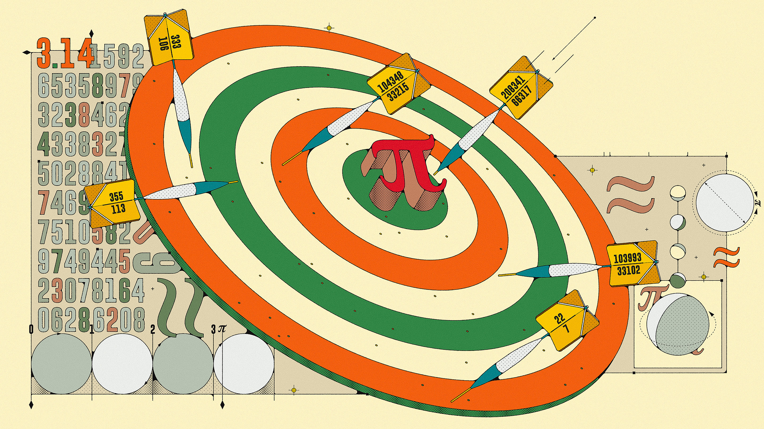
Approximation
INTRODUCTION TO COMPUTING
Course Code: CCINCOM/L
Approximation is a value or quantity that is nearly but not exactly the same to the actual value.
Joseph Marvin R. Imperial
REINFORCEMENT LEARNING
NU College of Computing and Information Technologies
Course Code: CCRNFLRL

Slide 9
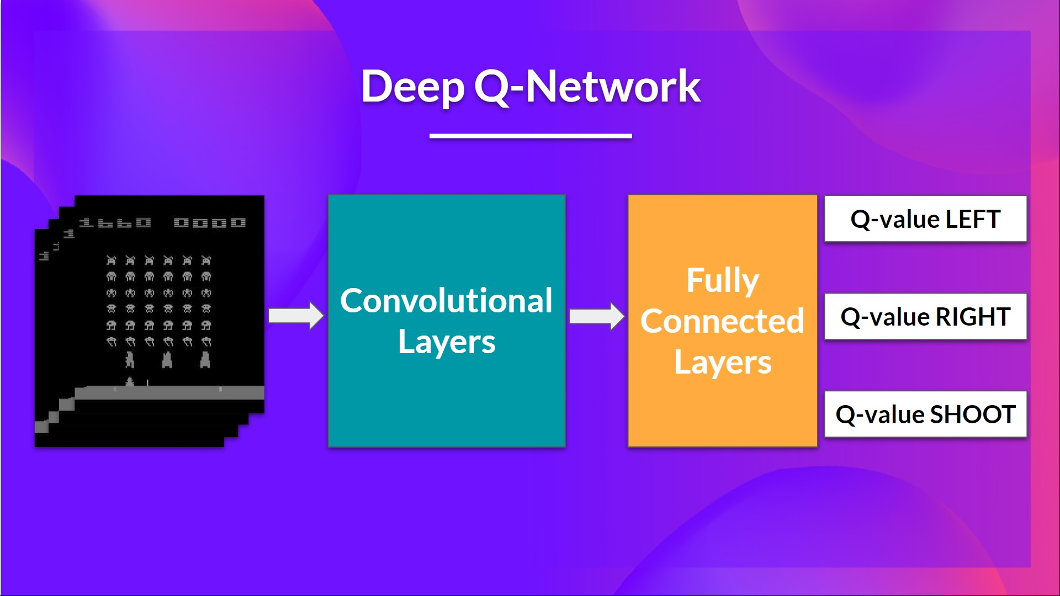
Deep Q-Network
INTRODUCTION TO COMPUTING
Course Code: CCINCOM/L
As input, we take a stack of 4 frames passed through the network as a state and output a vector of Q-values for each possible action at that state. Then, like with Q-Learning, we just need to use our epsilon-greedy policy to select which action to take.
When the Neural Network is initialized, the Q-value estimation is terrible. But during training, our Deep Q-Network agent will associate a situation with the appropriate action and learn to play the game well.
Joseph Marvin R. Imperial
REINFORCEMENT LEARNING
NU College of Computing and Information Technologies
Course Code: CCRNFLRL

Slide 10
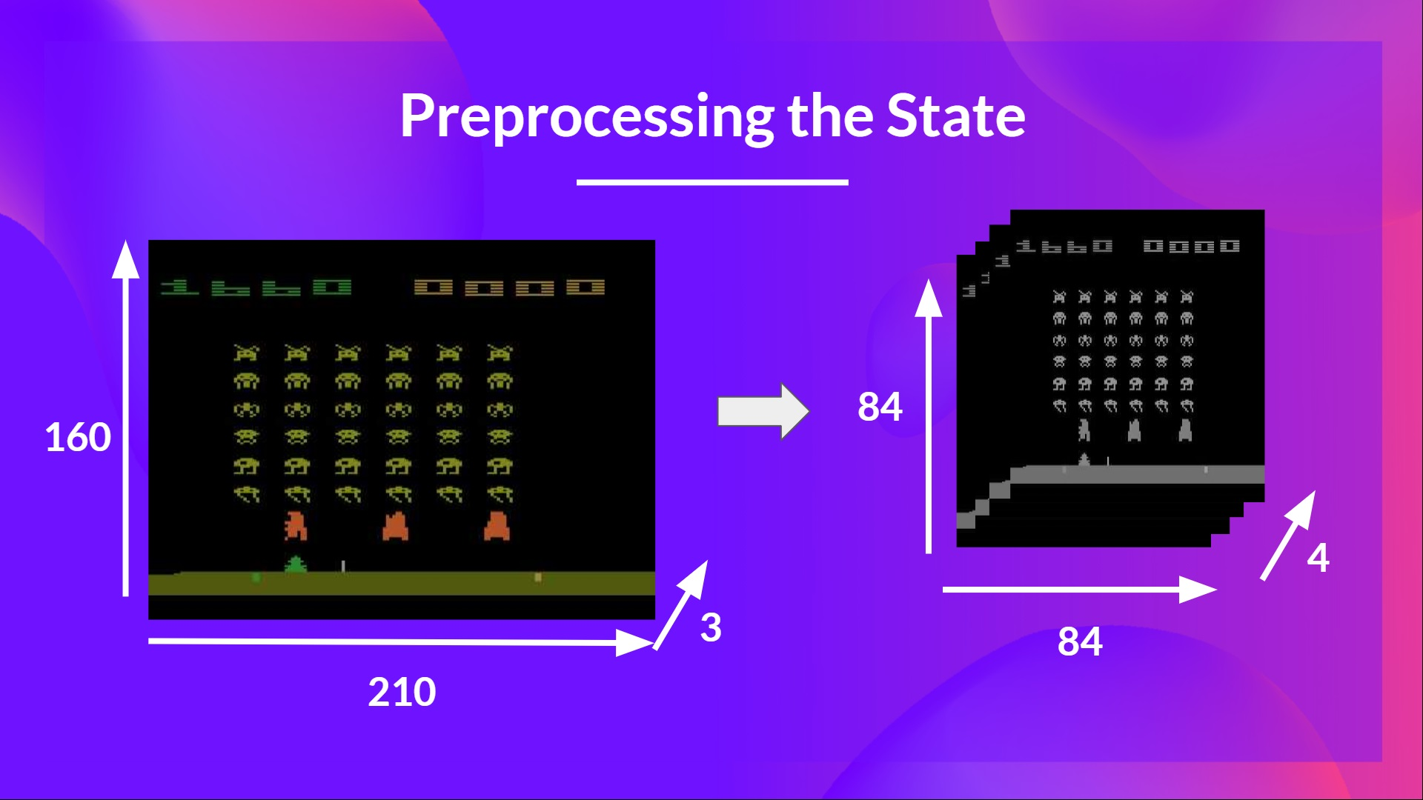
Preprocessing
INTRODUCTION TO COMPUTING
Course Code: CCINCOM/L
Reduce the state space to 84x84.
Grayscale each frame. Colors in Atari environments don’t add important information.
We can also crop a part of the screen in some games if it does not contain important information.
Stack four frames together.
Joseph Marvin R. Imperial
REINFORCEMENT LEARNING
NU College of Computing and Information Technologies
Course Code: CCRNFLRL

Slide 11
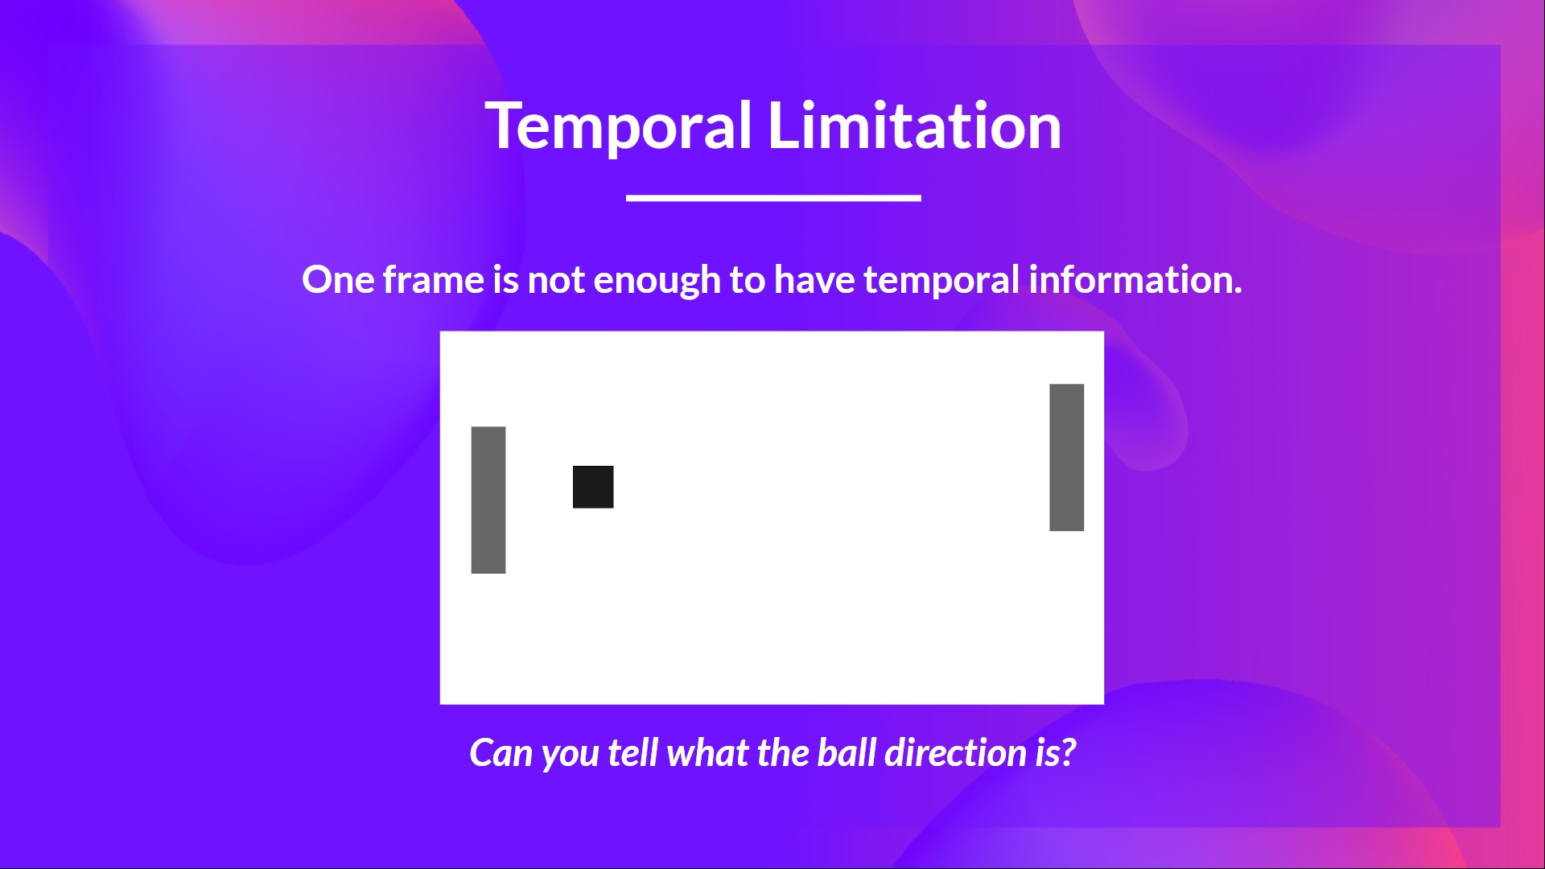
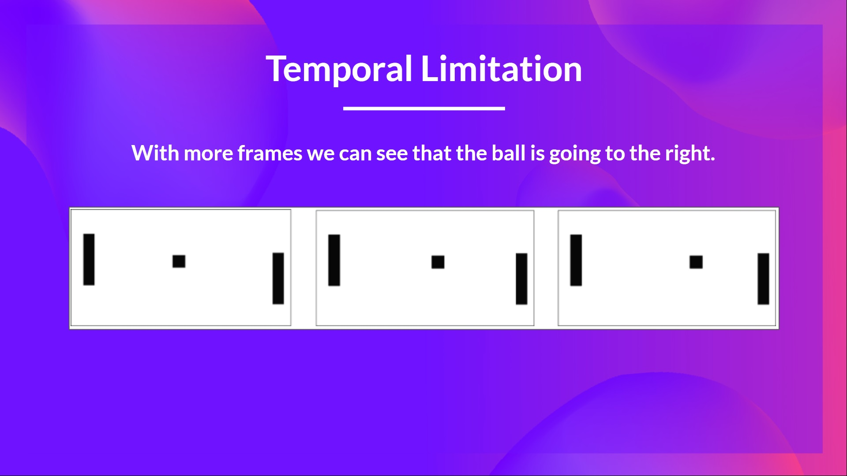
Stacking Frames
INTRODUCTION TO COMPUTING
Course Code: CCINCOM/L
Why do we stack four frames together? We stack frames together because it helps us handle the problem of temporal limitation.
Using only one frame is not enough to have a sense of motion. If we add three more frames, we can see the direction of the ball is going to the right.
Joseph Marvin R. Imperial
REINFORCEMENT LEARNING
NU College of Computing and Information Technologies
Course Code: CCRNFLRL

Slide 12
Stacking Frames
INTRODUCTION TO COMPUTING
Course Code: CCINCOM/L
Then the stacked frames are processed by three convolutional layers. These layers allow us to capture and exploit spatial relationships in images.
Finally, we have a couple of fully connected layers that output a Q-value for each possible action at that state.
Deep Q-Learning uses a neural network to approximate, given a state, the different Q-values for each possible action at that state.
Joseph Marvin R. Imperial
REINFORCEMENT LEARNING
NU College of Computing and Information Technologies
Course Code: CCRNFLRL

Slide 13
Q-Learning vs Deep Q-Learning
INTRODUCTION TO COMPUTING
Course Code: CCINCOM/L
In Q-Learning, we update the Q-value of a state-action pair during the training phase.
In Deep Q-Learning, we create a loss function that compares our Q-value prediction and the Q-target and uses gradient descent to update the weights of our Deep Q-Network to approximate our Q-values better.
Joseph Marvin R. Imperial
REINFORCEMENT LEARNING
NU College of Computing and Information Technologies
Course Code: CCRNFLRL

Slide 14
Deep Q-Learning Training Algorithm
INTRODUCTION TO COMPUTING
Course Code: CCINCOM/L
Two Phases:
Sampling
The agent perform actions and store the observed experience tuples in a replay memory.
Training
Select a small batch of tuples randomly and learn from this batch using a gradient descent update step.
Joseph Marvin R. Imperial
REINFORCEMENT LEARNING
NU College of Computing and Information Technologies
Course Code: CCRNFLRL

Slide 15
Deep Q-Learning Training Algorithm
INTRODUCTION TO COMPUTING
Course Code: CCINCOM/L
Deep Q-Learning training might suffer from instability, mainly because of combining a non-linear Q-value function (Neural Network) and bootstrapping (when we update targets with existing estimates and not an actual complete return).
To help us stabilize the training, we implement three different solutions:
Experience Replay to make more efficient use of experiences.
Fixed Q-Target to stabilize the training.
Double Deep Q-Learning, to handle the problem of the overestimation of Q-values.
Joseph Marvin R. Imperial
REINFORCEMENT LEARNING
NU College of Computing and Information Technologies
Course Code: CCRNFLRL

Slide 16
Experience Replay
INTRODUCTION TO COMPUTING
Course Code: CCINCOM/L
Experience Replay to make more efficient use of experiences
Experience Replay in Deep Q-Learning has two functions:
Make more efficient use of the experiences during the training. Usually, in online reinforcement learning, the agent interacts with the environment, gets experiences learns from them and discards them. This is not efficient.
Experience replay helps by using the experiences of the training more efficiently. We use a replay buffer that saves experience samples that we can reuse during the training.
This allows the agent to learn from the same experiences multiple times.
Joseph Marvin R. Imperial
REINFORCEMENT LEARNING
NU College of Computing and Information Technologies
Course Code: CCRNFLRL

Slide 17
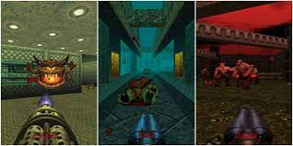

Experience Replay
INTRODUCTION TO COMPUTING
Course Code: CCINCOM/L
Avoid forgetting previous experiences and reduce the correlation between experiences.
The problem we get if we give sequential samples of experiences to our neural network is that it tends to forget the previous experiences as it gets new experiences. For instance, if the agent is in the first level and then in the second, which is different, it can forget how to behave and play in the first level.
Joseph Marvin R. Imperial
REINFORCEMENT LEARNING
NU College of Computing and Information Technologies
Course Code: CCRNFLRL

Slide 18
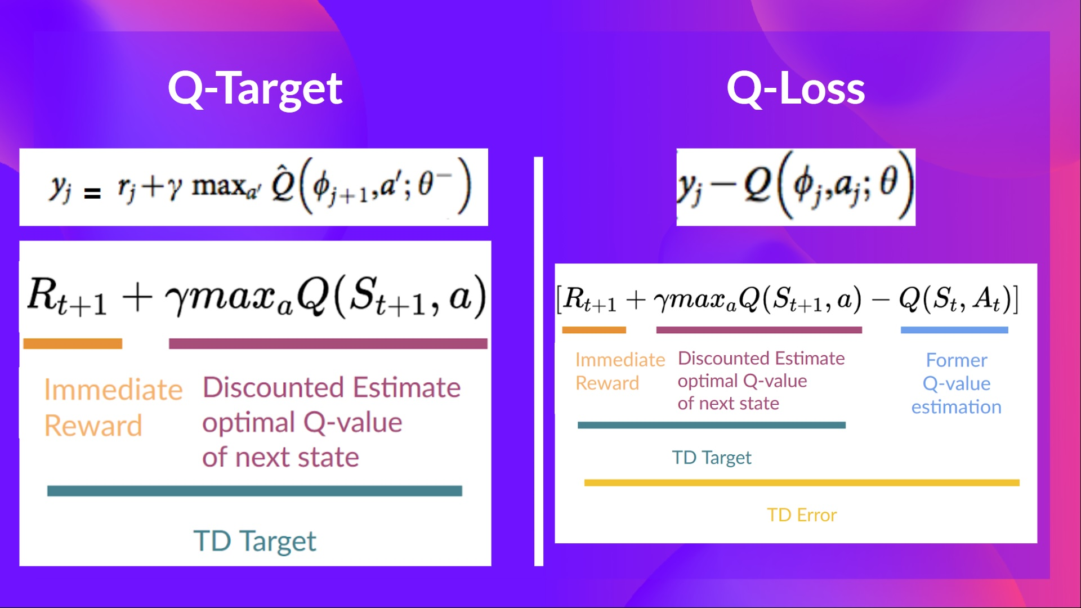

Fixed Q-target
INTRODUCTION TO COMPUTING
Course Code: CCINCOM/L
When we want to calculate the TD error (aka the loss), we calculate the difference between the TD target (Q-Target)
and the current Q-value (estimation of Q).
But we don’t have any idea of the real TD target. We need to estimate it.
Using the Bellman equation, we saw that the TD target is just the reward of taking that action at that state plus the discounted highest Q value for the next state.
Joseph Marvin R. Imperial
REINFORCEMENT LEARNING
NU College of Computing and Information Technologies
Course Code: CCRNFLRL

Slide 19
Fixed Q-target
INTRODUCTION TO COMPUTING
Course Code: CCINCOM/L
When we want to calculate the TD error (aka the loss), we calculate the difference between the TD target (Q-Target) and the current Q-value (estimation of Q).
But we don’t have any idea of the real TD target. We need to estimate it.
Using the Bellman equation, we saw that the TD target is just the reward of taking that action at that state plus the discounted highest Q value for the next state.
However, the problem is that we are using the same parameters (weights) for estimating the TD target and the Q-value.
Consequently, there is a significant correlation between the TD target and the parameters we are changing.
Therefore, at every step of training, both our Q-values and the target values shift.
Joseph Marvin R. Imperial
REINFORCEMENT LEARNING
NU College of Computing and Information Technologies
Course Code: CCRNFLRL

Slide 20
Double DQN
INTRODUCTION TO COMPUTING
Course Code: CCINCOM/L
Use a separate network with fixed parameters for estimating the TD Target
Copy the parameters from our Deep Q-Network every C steps to update the target network.
DQN network
Select the best action to take for the next state (the action with the highest Q-value).
Target network
Calculates the target Q-value of taking that action at the next state.
Joseph Marvin R. Imperial
REINFORCEMENT LEARNING
NU College of Computing and Information Technologies
Course Code: CCRNFLRL

Slide 21
References
INTRODUCTION TO COMPUTING
Course Code: CCINCOM/L
Images are licensed with Creative Commons. Can use without citing.
Prof. Emma Brunskill’s slides (CS234RL). https://web.stanford.edu/class/cs234/slides/lecture1.pdf
David Silver’s slides. https://www.davidsilver.uk/wp-content/uploads/2020/03/intro_RL.pdf
https://huggingface.co/learn/deep-rl-course/unit3/deep-q-algorithm?fw=pt
Review in Probability, Intro to RL Concepts
Joseph Marvin R. Imperial
REINFORCEMENT LEARNING
NU College of Computing and Information Technologies
Course Code: CCRNFLRL

